Slide 1
Airplane Crashes Analysis With Power bi
Md Mehedi Hasan
Data Analysis Intern
Mentorness

Slide 2
Contents
Problem Statement
•Objective
•Data Cleaning
•Analysis
Fatality Analysis
Temporal Analysis
Geospatial Analysis

Slide 3
Problem Statement
This internship project aims to analyze airplane crashes and fatalities spanning from 1980 to 2023, using Power BI for interactive visualizations and insights. By examining crucial data such as crash dates, locations, operators, flight details, aircraft types, and fatality statistics, the goal is to uncover patterns, contributing factors, and trends in aviation incidents. Ultimately, this analysis seeks to provide stakeholders with actionable insights to enhance aviation safety and mitigate risks

Slide 4
OBJECTIVE
Temporal Analysis: -Explore temporal trends in airplane crashes over the years. -Identify patterns in the frequency and severity of incidents.
Geospatial Analysis: -Visualize crash locations on a map to identify hotspots. -Analyze the distribution of incidents across different regions.
Fatality Trends: -Explore trends in passenger and crew fatalities. -Investigate factors contributing to fatalities.
Route Analysis: Aircraft Analysis: -Analyze the involvement of specific aircraft types in incidents. -Examine the relationship between aircraft registration and crash occurrences..
Route Analysis: -Analyze incident patterns on specific flight routes. -Identify routes with a higher likelihood of incidents. Operator Performance: -Evaluate the safety records of different operators and airlines. -Identify operators with higher incident rates

Slide 5
Data Cleaning Process
Temporal Analysis: -Explore temporal trends in airplane crashes over the years. -Identify patterns in the frequency and severity of incidents.
Geospatial Analysis: -Visualize crash locations on a map to identify hotspots. -Analyze the distribution of incidents across different regions.
Fatality Trends: -Explore trends in passenger and crew fatalities. -Investigate factors contributing to fatalities.
Route Analysis: Aircraft Analysis: -Analyze the involvement of specific aircraft types in incidents. -Examine the relationship between aircraft registration and crash occurrences..
Route Analysis: -Analyze incident patterns on specific flight routes. -Identify routes with a higher likelihood of incidents. Operator Performance: -Evaluate the safety records of different operators and airlines. -Identify operators with higher incident rates

Slide 6
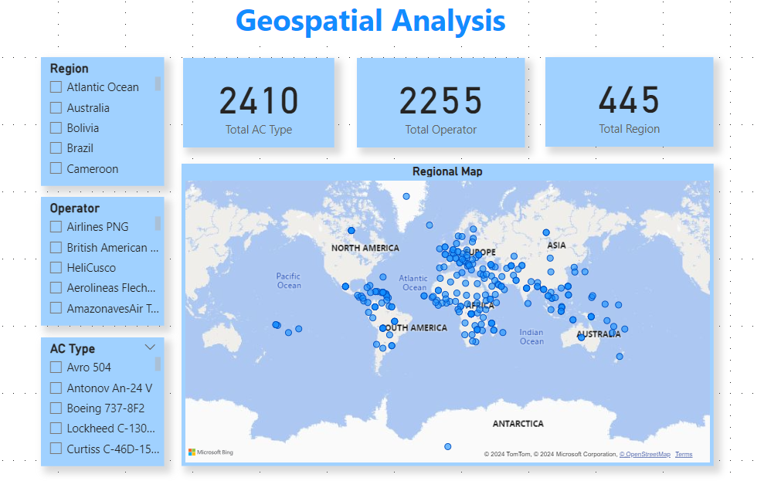

Slide 7
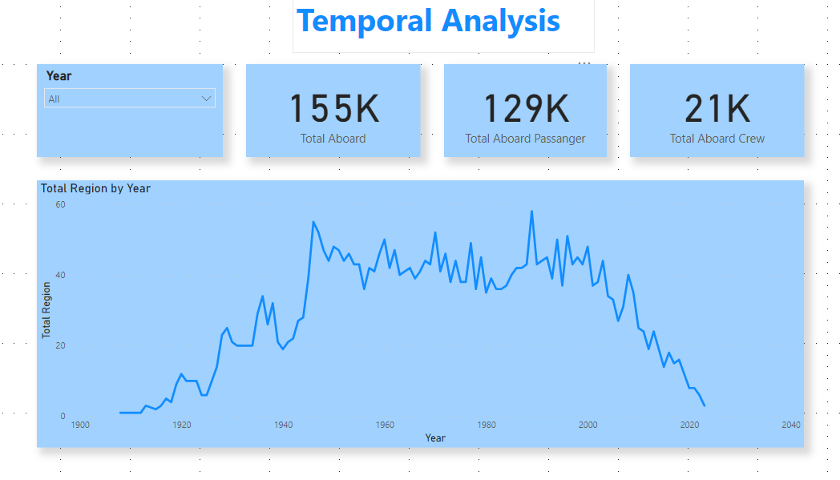

Slide 8
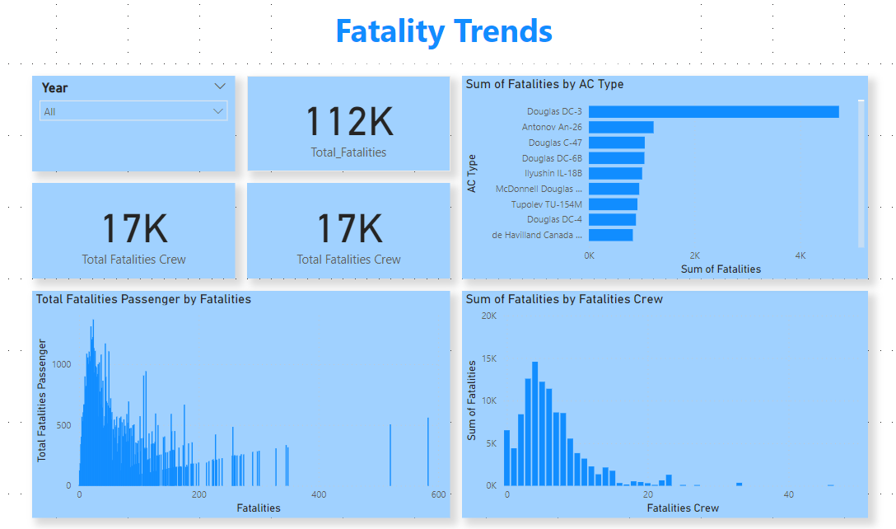

Slide 9
Thank you

